Slide 1

Providers of Solutions:
Between Innovation and Legitimation

Slide 2

The Rhetoric Game (Berglund and Werr)
"Consultants simultaneously deploy two incompatible rhetorics […] seamlessly
blending whichever is needed in the moment."
Expert Rhetoric
Creative Rhetoric
"We bring rigorous methodology and superior knowledge. Trust our expertise."
"We're flexible practitioners who adapt to your unique situation. We'll craft something bespoke."
This represents a genuine tension in consulting. Be clear on what the client wants and what you do.

Slide 3

Innovation vs Legitimation (Sturdy)
Innovation
Legitimation
Bringing ideas the client couldn't generate internally.
The recommendation itself is valuable.
Providing external validation for existing beliefs.
Enabling action through credibility and analysis.

Slide 4

Designing for Innovation
Build from Principles
Construct from first principles & external insights.
Create Experiences
Design tangible trials to demonstrate value.
Beware of arrogance here — even if the clients needs your expertise, they still know many valuable things. Consider strengths (positive deviance).
Anticipate Scepticism
Find Champions
Ensure solution clearly addresses felt pain points.
Engage internal advocates to drive adoption.

Slide 5

Designing for Legitimation
The risk: Becoming a rubber stamp. Good consultants validate what's genuinely valid & don't manufacture support for bad ideas.
Identify Stakeholders
Provide Evidence
List decision-makers and influence pathways.
Deliver rigorous data and external credibility.
Legitimation done well strengthens good decisions. Legitimation done poorly enables bad ones.
Understand Beliefs
Empower Advocates
Map client assumptions and underlying reasons.
Equip internal champions with clear assets.

Slide 6

GROUNDHOG DAY
Three Pathways to Solutions
Problem Seeks Solution
Solution Seeks Problem
Co-production
Client has a problem, consultant diagnoses it, recommendation follows logically.
Consultancy has a preferred methodology and frames client struggles to fit it.
Solution emerges from interaction between consultant and client.
Consultant-recommendations adapted "like recipes from cookbooks".
The textbook version, but less common than we pretend.
Common, but requires honesty about what you're doing.
Co-production is common — and the most likely path to success (Sturdy).

Slide 7
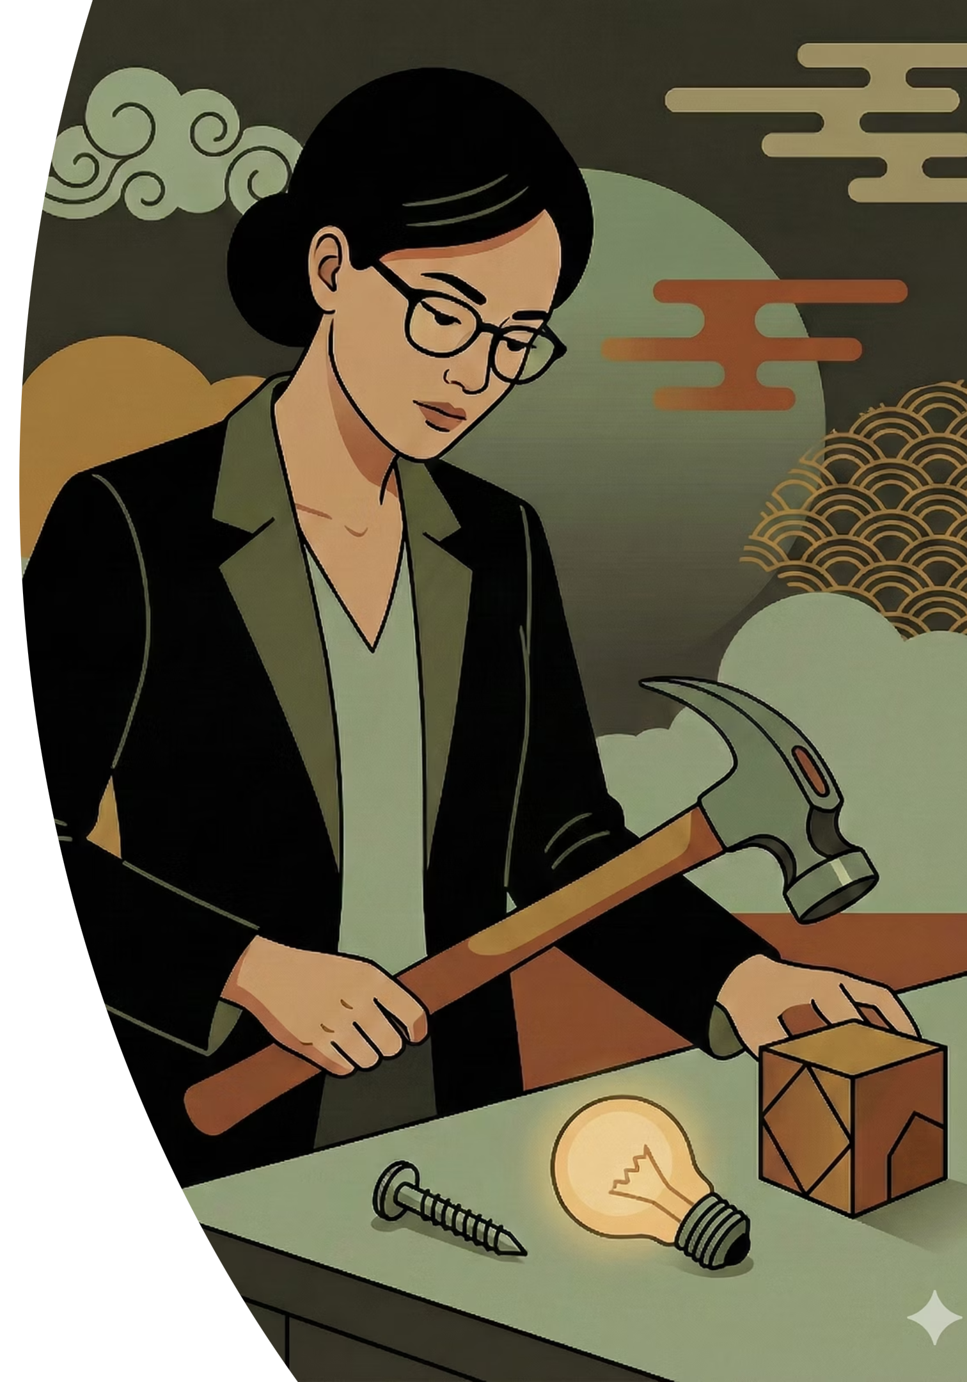



Solution-Seeks-Problem Trap
Psychometrician tend to see The Myers-Briggs Type Indicator as "little more than an elaborate Chinese fortune cookie" (Robert Hogan)
Why does it persist?
Is there a pattern?
Easy to administer, clients enjoy it, creates memorable team bonding moments.
Every consultancy has methodologies they're skilled at and eager to apply.
Emotional resonance matters more than scientific validity.
Avoid seeing every client problem through the lens of your favourite solution.
Check yourself: Are you recommending this because it fits the problem, or just because it's what you know how to deliver?

Slide 8



Quality Criteria for Solution Design
Three dimensions matter — and the weakest link can break the chain.
Evidence Quality
Problem Fit
Stakeholder Readiness
Is your recommendation grounded in solid evidence? Have you triangulated across sources? Are you distinguishing facts from assumptions?
Does your solution address the real problem—not just the presenting problem? Sometimes structural issues are relationship problems; skills gaps are motivation gaps.
Have you designed for the people who need to act? Will they be willing and able to play their part?
Only an implemented solution is a good solution.

Slide 9



Giving Up the Hero Narrative
Quite seductive: you're the outsider who sees what insiders miss, arrives with superior tools, saves the struggling organisation.
BUT:
Breeds Arrogance
Creates Dependency
Invites Blame
Blinds you to what clients know and understand about their own organisation
Builds reliance on external expertise rather than internal capability
Sets you up for failure when things go wrong …. you took the position as having all the answers
Process consultation (Schein's approach) —takes the opposite view.
The client owns the problem and the solution.
Your job is to help them see more clearly, not to rescue them.
And it helps: Solutions designed collaboratively get implemented; solutions imposed heroically get resisted.

Slide 10
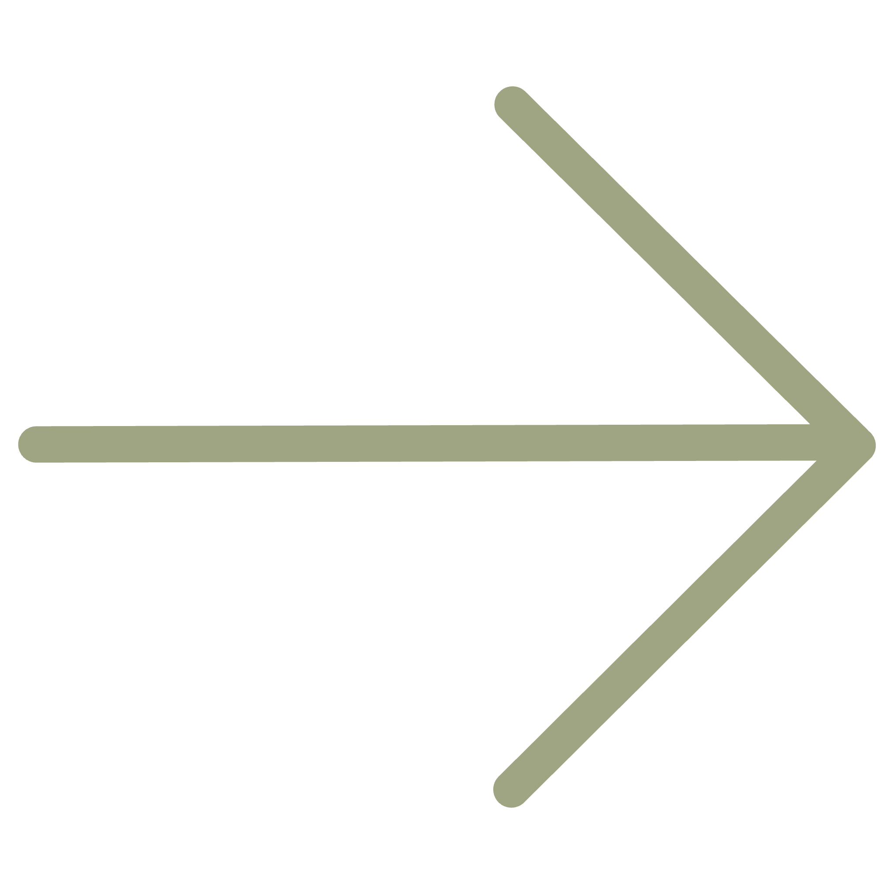
NEXT RECORDING
Designing for Adoption
Reflection Prompt
In the end, your value comes through implementation (especially in legitimation mode). So designing for adoption is at the core of what you're delivering.
Think about a time someone told you something you already knew. Did it change anything? What would have made it more likely to lead to action?

